Slide 1
Year 4 Multiplication Tables Check (MTC) 2024

Slide 2
Key information about multiplication tables check (MTC):
The MTC determines if Year 4 children can fluently recall their multiplication tables up to 12 x 12.
They are designed to help schools identify which children require more support to learn their times tables.
There is no ‘pass’ rate or threshold which means that, unlike the Phonics Screening Check, children will not be expected to re-sit the check.
The Department for Education (DfE) will create a report about the overall results across all schools in England, not individual schools.

Slide 3
When the check will take place:
There will be a 3 week window from Monday 3rd June to Friday 21st June 2023 for schools to administer the check. However week three is a back up in case of absence or technical failure.
There is no set day to administer the check and children are not expected to take the check at the same time.
All eligible Year 4 children in England will be required to take the check.
Getting ready:
TTR practise in school/ Maths frame check/ ‘Try it out’ area, provided by the DfE, which we will use in school.

Slide 4
How the check is carried out:
The check will be fully digital.
Answers will be entered using a keyboard, by pressing digits using a mouse or using an on-screen number pad.
Usually, the check will take less than 5 minutes for each child.
The children will have 6 seconds from the time the question appears to input their answer.
There will be a total of 25 questions with a 3 second pause in-between questions.
There will be 3 practice questions before the check begins.

Slide 5
Specific arrangements for the check:
Some children will be eligible for specific arrangements:
Colour contrast;
Font size adjustment;
‘Next’ button (alternative to 3-second pause);
Removing on-screen number pad;
An adult to input answers;
Audio version;
Audible time alert.
We will trial these, to see if they could work for your child beforehand.

Slide 6
The check questions:
Each child will be randomly assigned a set of questions
There will only be multiplication questions in the check, not division facts.
The 6, 7, 8, 9 and 12 times tables are more likely to be asked, as these are the hardest for most children to learn. It’s a good idea to focus on these tricky times tables with your child at home.
Reversal of questions (e.g. 8 x 6 and 6 x 8) will not be asked in the same check.
Children will not see their individual results when they complete the check.

Slide 7
How best to prepare your child for the check:
Remind them that the check should last no more than 5 minutes.
If you want to go over times tables, make them fun (Rockstars and Ed Shed have some good ways of learning times tables and school pay for these).
If your child has any concerns, encourage them to talk to a trusted adult (for example, yourself, their teacher).
If you’re looking to support your child further with maths at home, there are lots of other good websites with free resources.
We are having 3 x 45 minute sessions per week in school to prepare this half term.

Slide 8
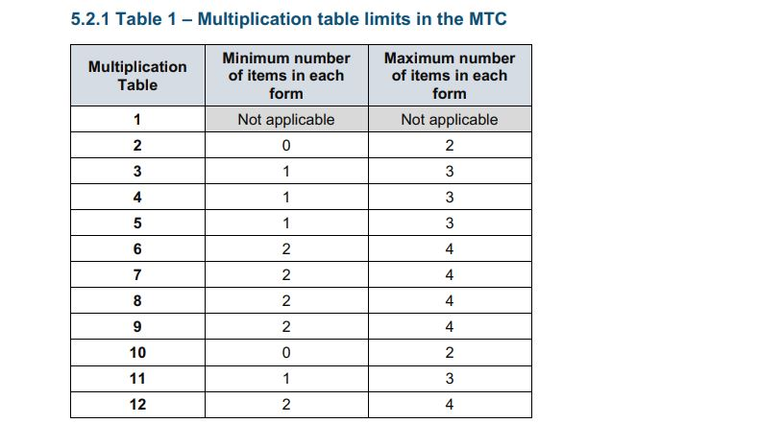
More information about the check:
The Standards and Testing Agency (STA) state that they are classifying the multiplication tables by the first number in the question. For example, 8 x 3 would fall within the 8 times table.

Slide 9
Ways to try:
Count and look for patterns.
Understand that multiplication is repeated addition. Remember that multiplication is the inverse of division.
Recall and utilise number families.
Climb the stairs counting in multiples.
Play time tables games verbally.
Deal out a pack of cards and multiply the pairs.
Listen and sing along to times tables songs - YouTube.
Play maths games online:
Hit the Button: https://www.topmarks.co.uk/maths-games/hit-the-button
Time table games: https://www.timestables.co.uk/games/
Maths frame: https://mathsframe.co.uk/en/resources/resource/477/Multiplication-Tables-Check
TT Rockstars: https://ttrockstars.com/

Slide 10
Quick (free demo) of what it nearly looks like!
https://talkingtimestables.uk/y4_ks2_mtc_practice_tests_multiplication_tables_check.php

Slide 11
How best to prepare:
Remind them that the check should last no more than 5 minutes.
If you want to go over times tables, make them fun.
If you have any concerns, talk to your child’s teacher.
If your child has any concerns, encourage them to talk to a trusted adult (for example, yourself, their teacher).

Slide 12
We really thank you for your support with this matter and wish our Y4 pupils all the best for the upcoming MTC in June 2024.
Thank for taking the time to come and listen to this information today.

